Slide 1

SUSTech CS205 C/C++ Review & 串讲
赖海斌
12211612@mail.sustech.edu.cn

Slide 2
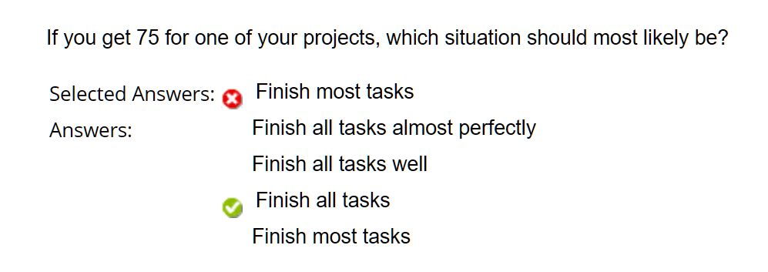

About this lecture
ShiqiYu/CPP: Lecture notes, projects and other materials for Course 'CS205 C/C++ Program Design' at Southern University of Science and Technology. (github.com)
C/C++在学什么？
Project 是真正学习到C/C++的地方
看别人的Project Report，会学习到很多东西

Slide 3
About this review ppt
这是复习，不是预习
可能会讲点自己探索的，所以有错误还请及时指出

Slide 4
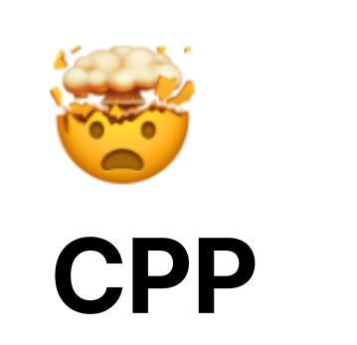
Acknowledgement
cpp.pdf
YanWQ-monad/SUSTech_CS205_Projects: SUSTech CS205 (C/C++ Program Design) Projects, taught by Shiqi Yu, 2022F (github.com)

Slide 5
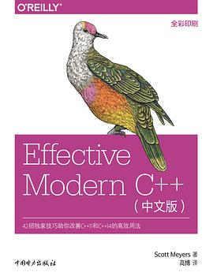
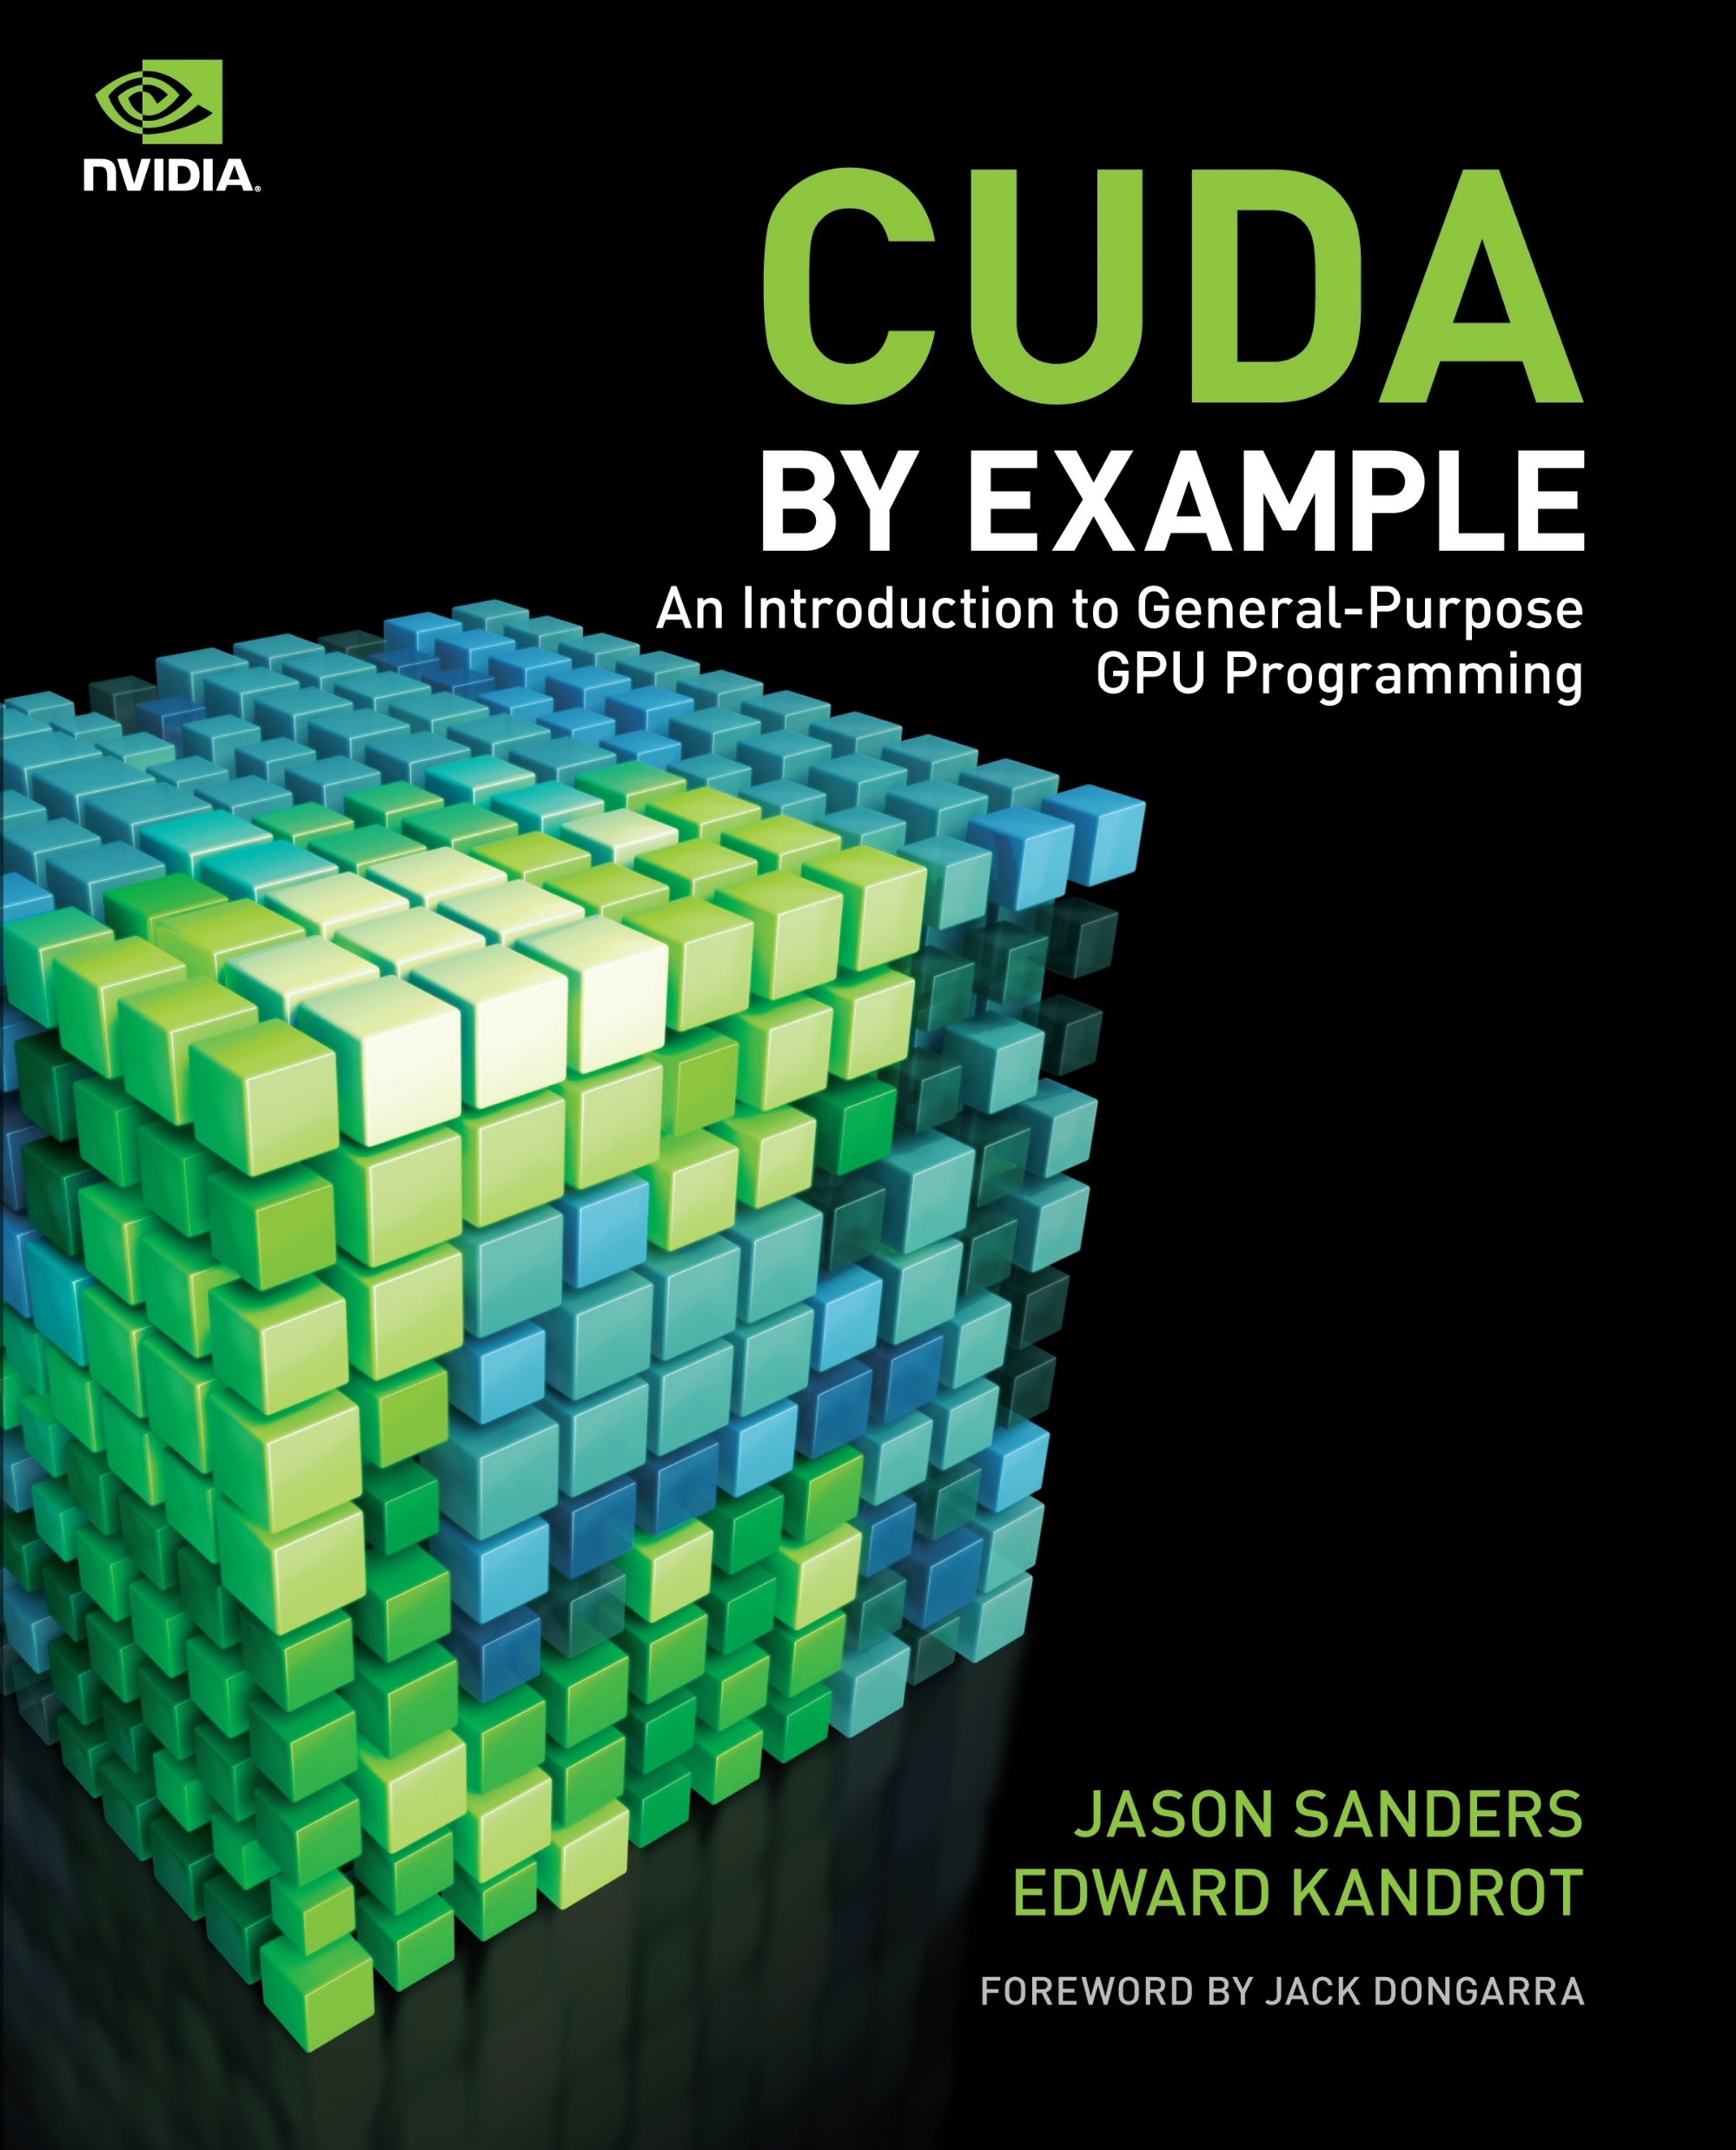
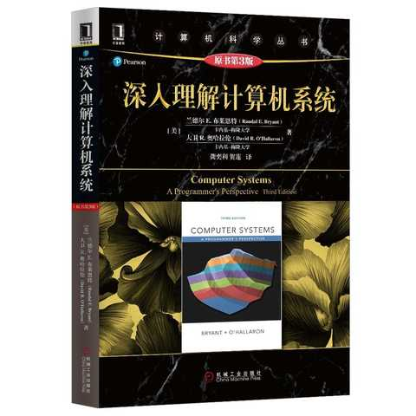
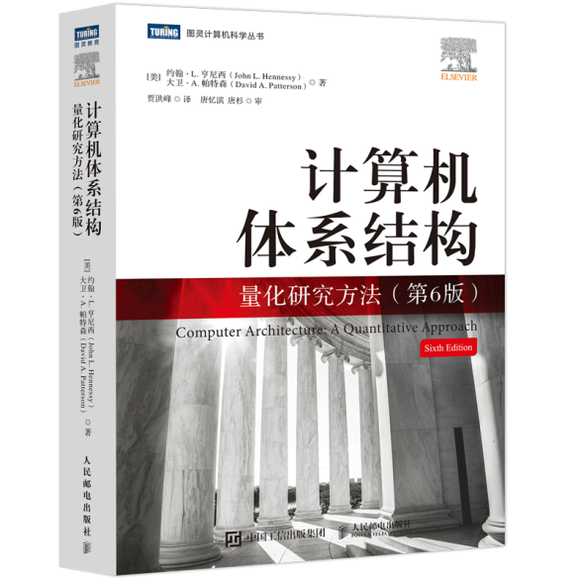
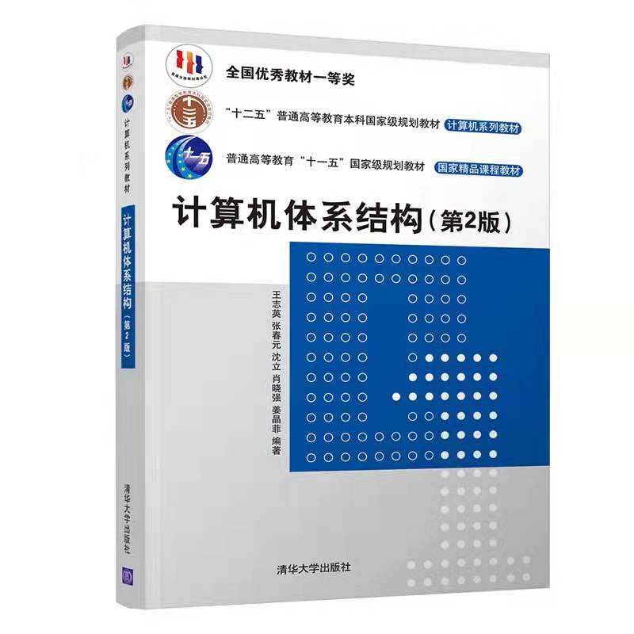
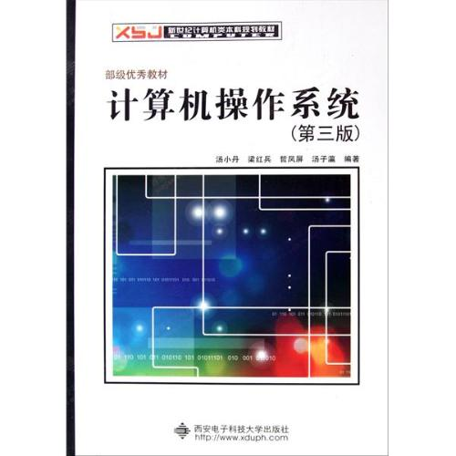
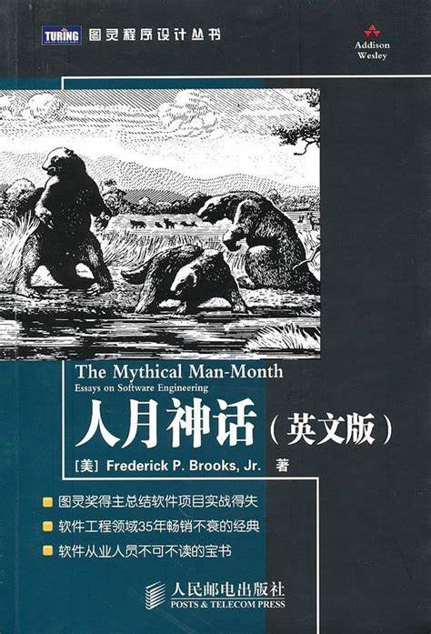
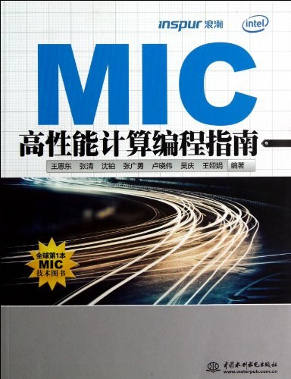
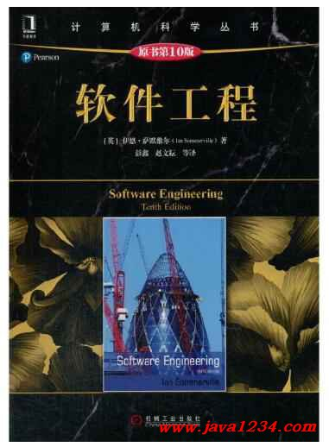
参考阅读书目
Effective Modern C++ (cntransgroup.github.io)

Slide 6

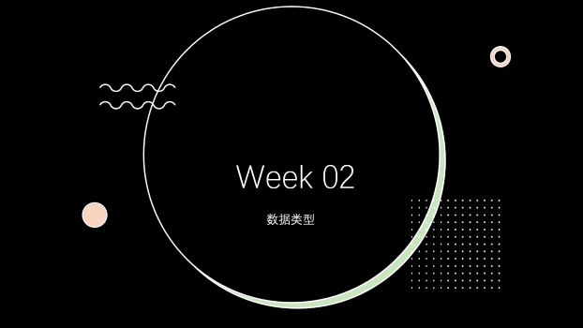
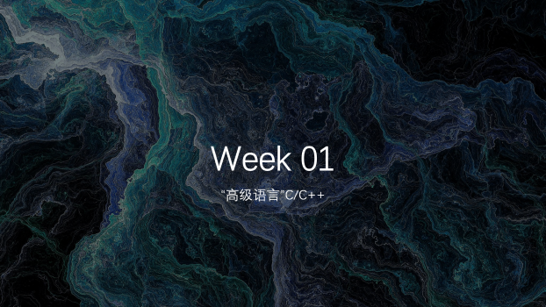
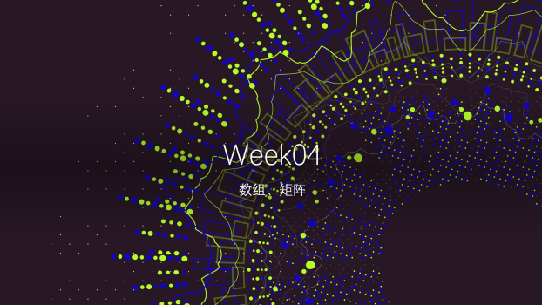
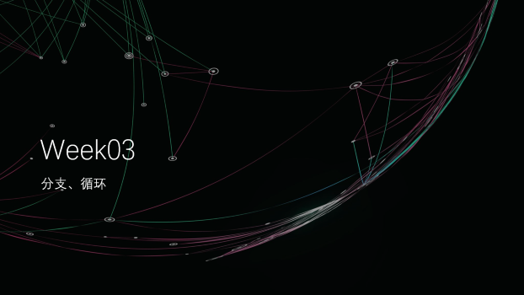
Content 1

Slide 7





Content 2

Slide 8





Content 3

Slide 9

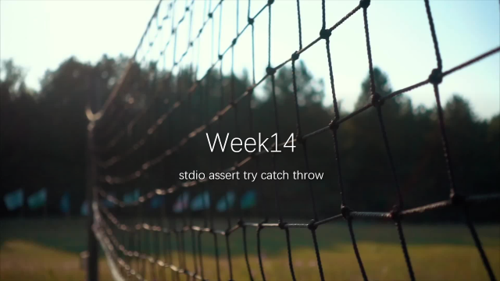
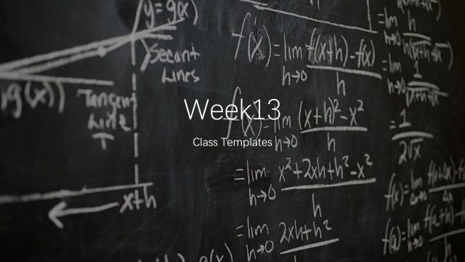
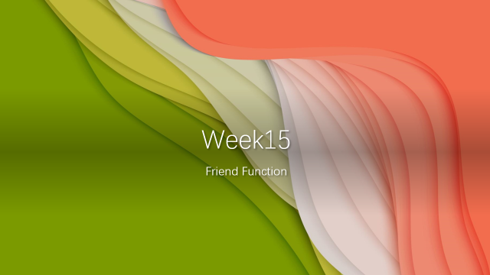
Content 4

Slide 10

Thanks!

Slide 11

Week 01
“高级语言”C/C++

Slide 12
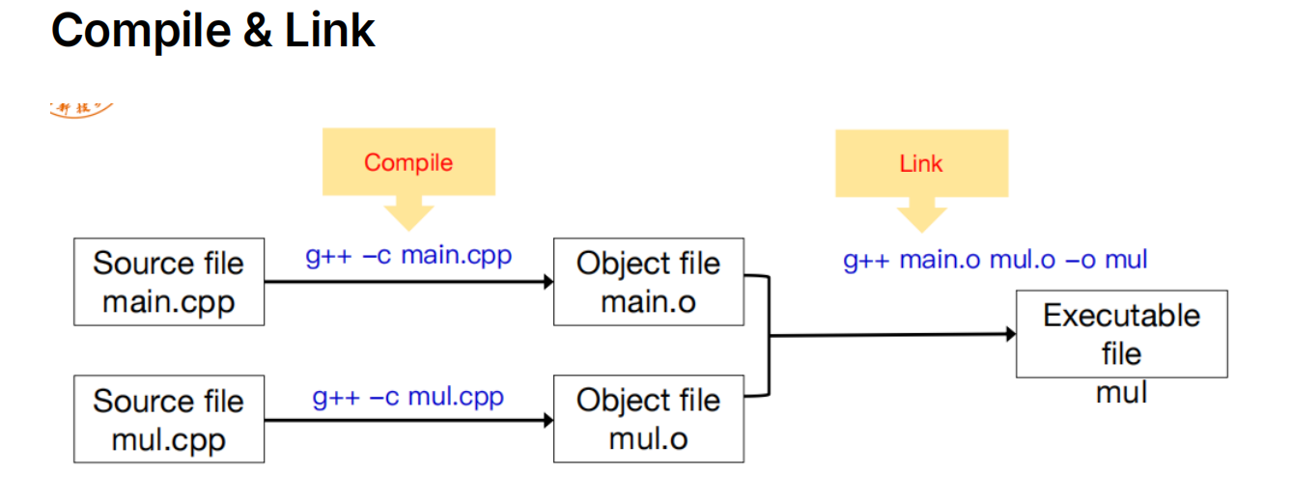
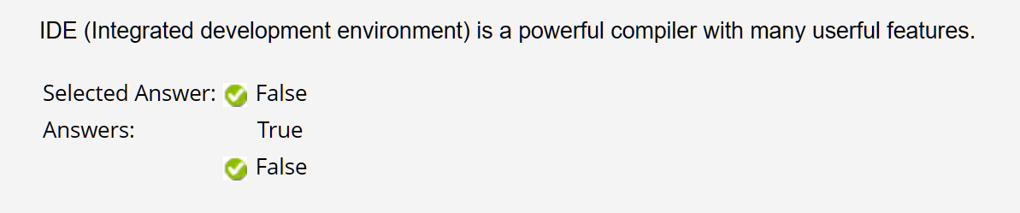

Slide 13
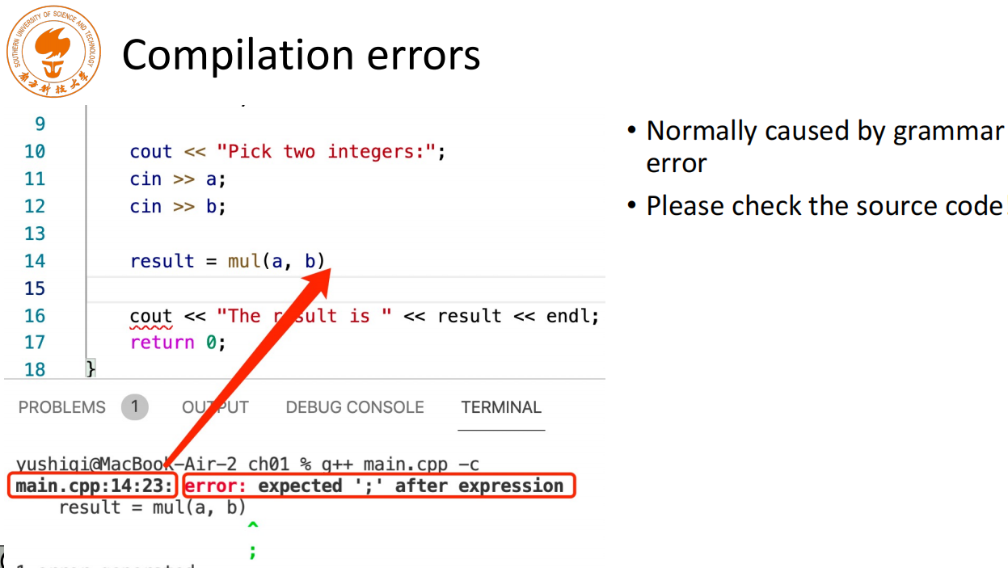
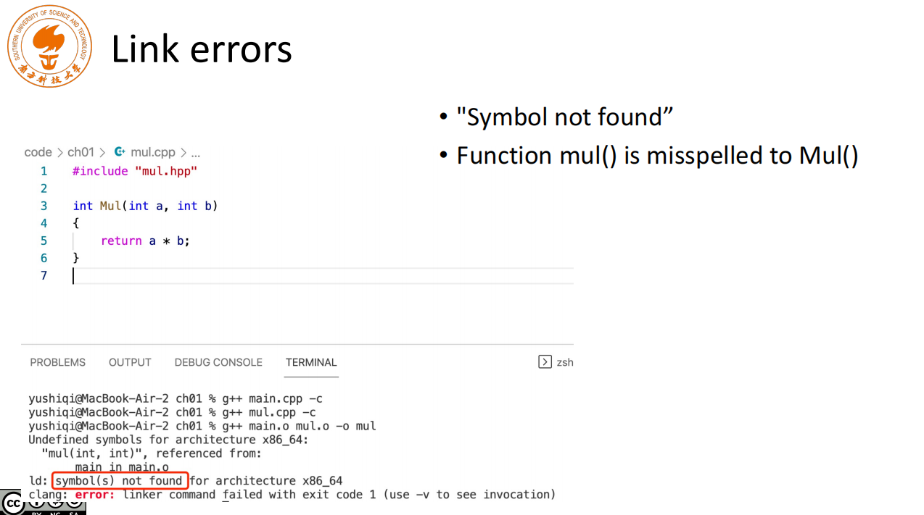
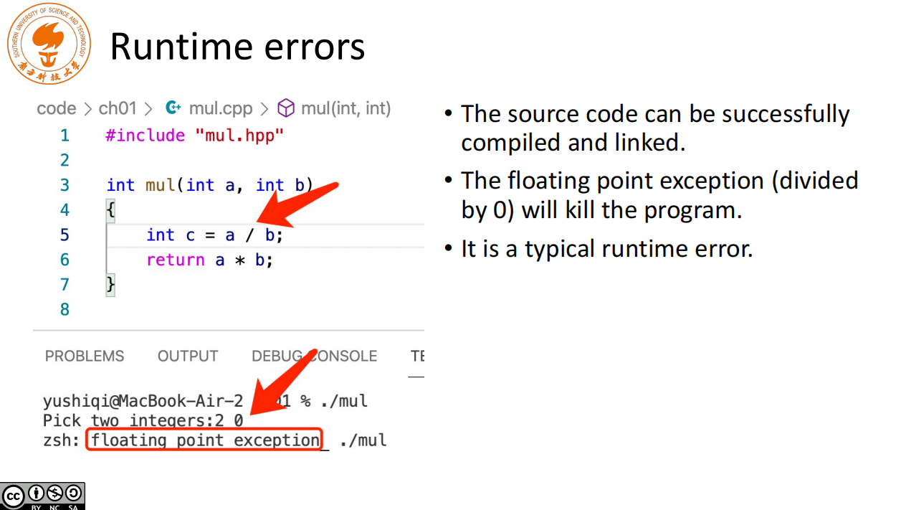
几种error

Slide 14
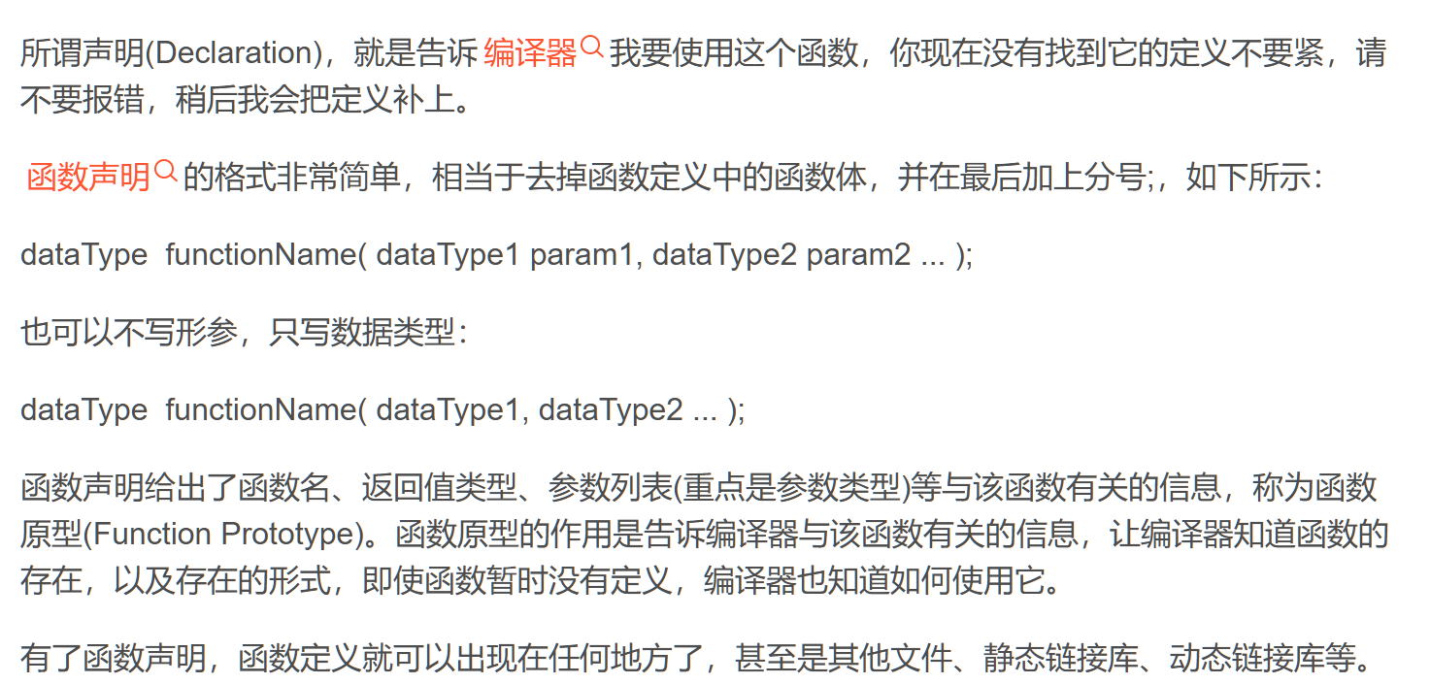
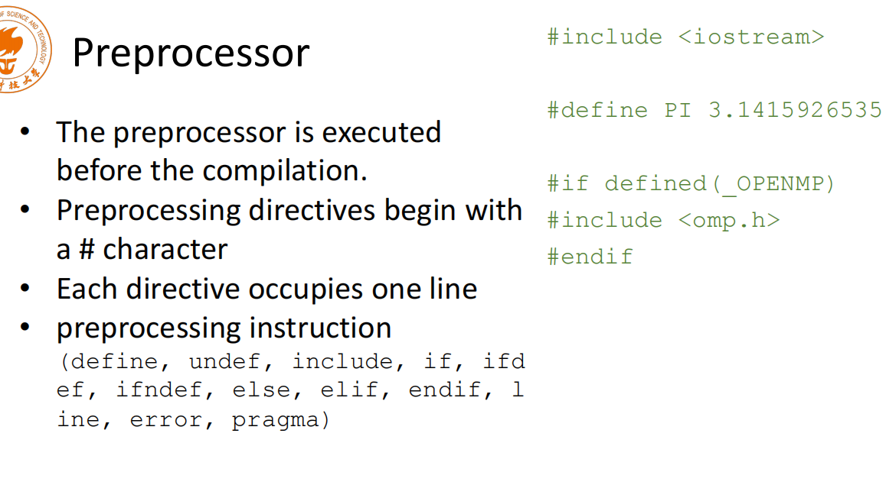
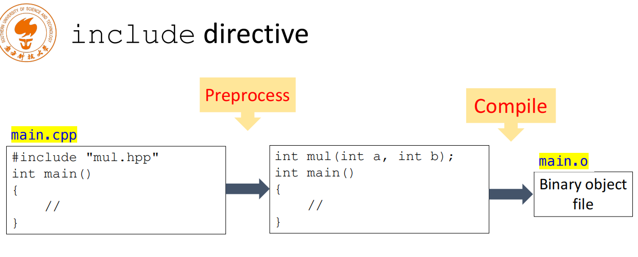
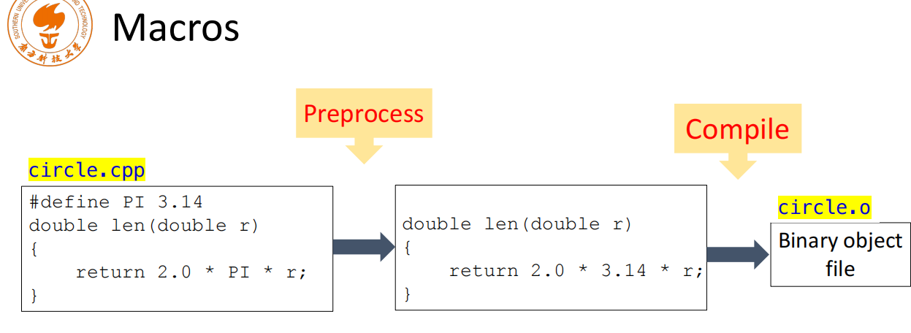
预编译&宏&声明

Slide 15
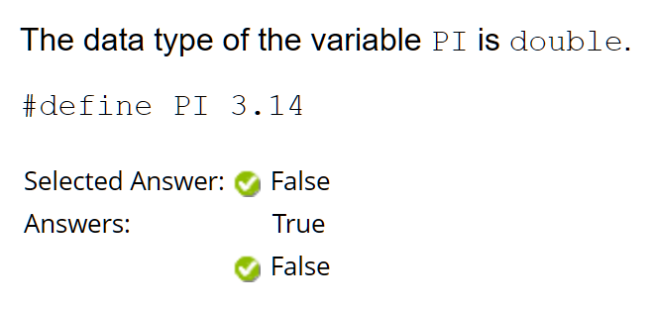
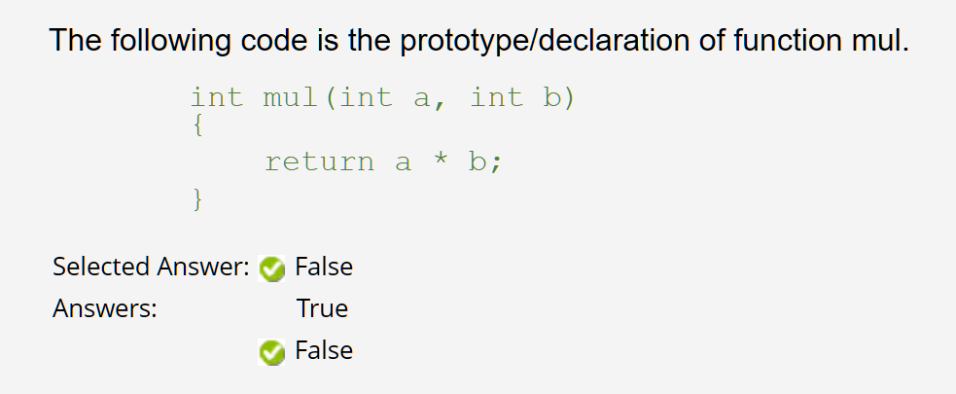
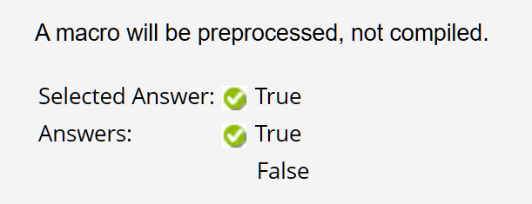

Slide 16
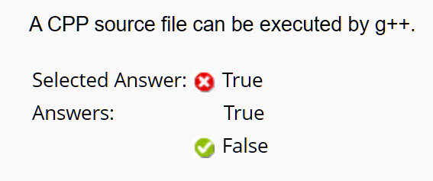
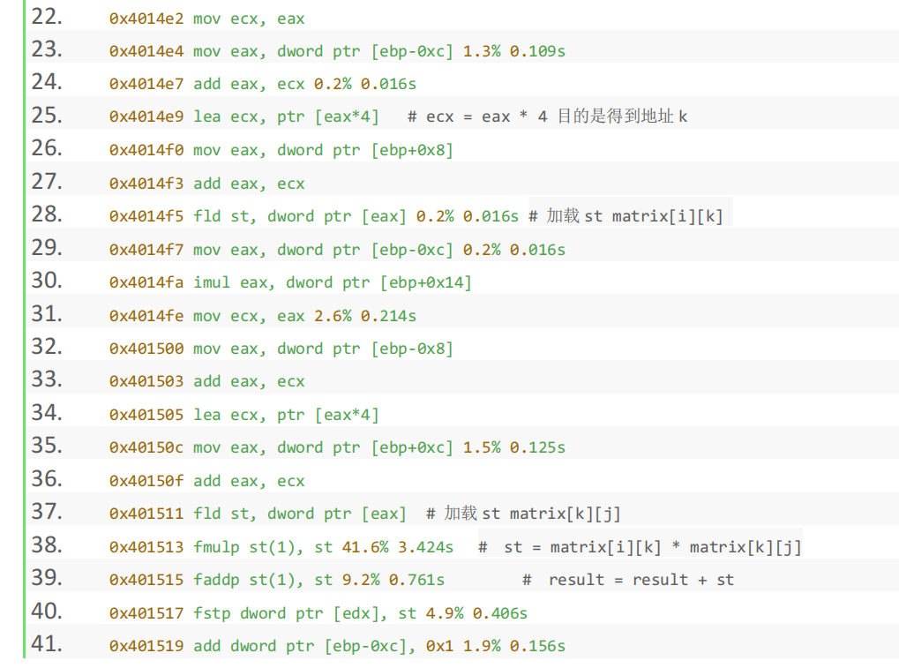
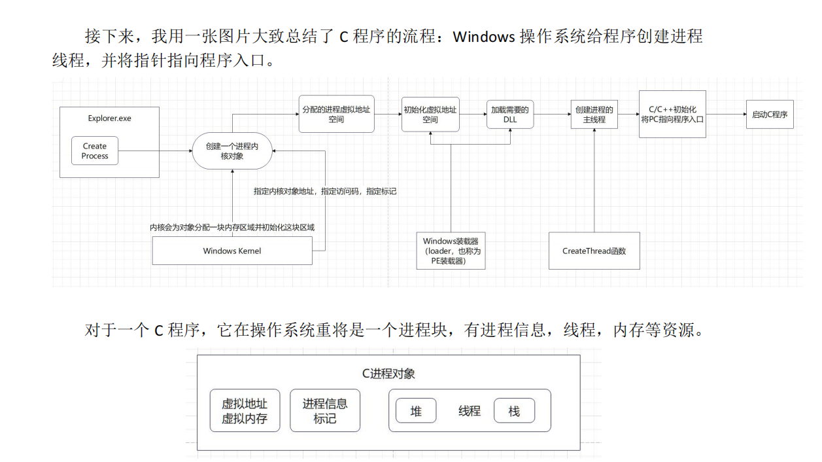
怎么链接的？怎么编译的？怎么启动的？
详见Project2

Slide 17
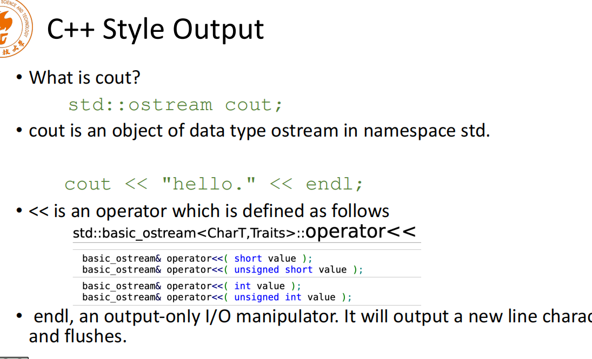
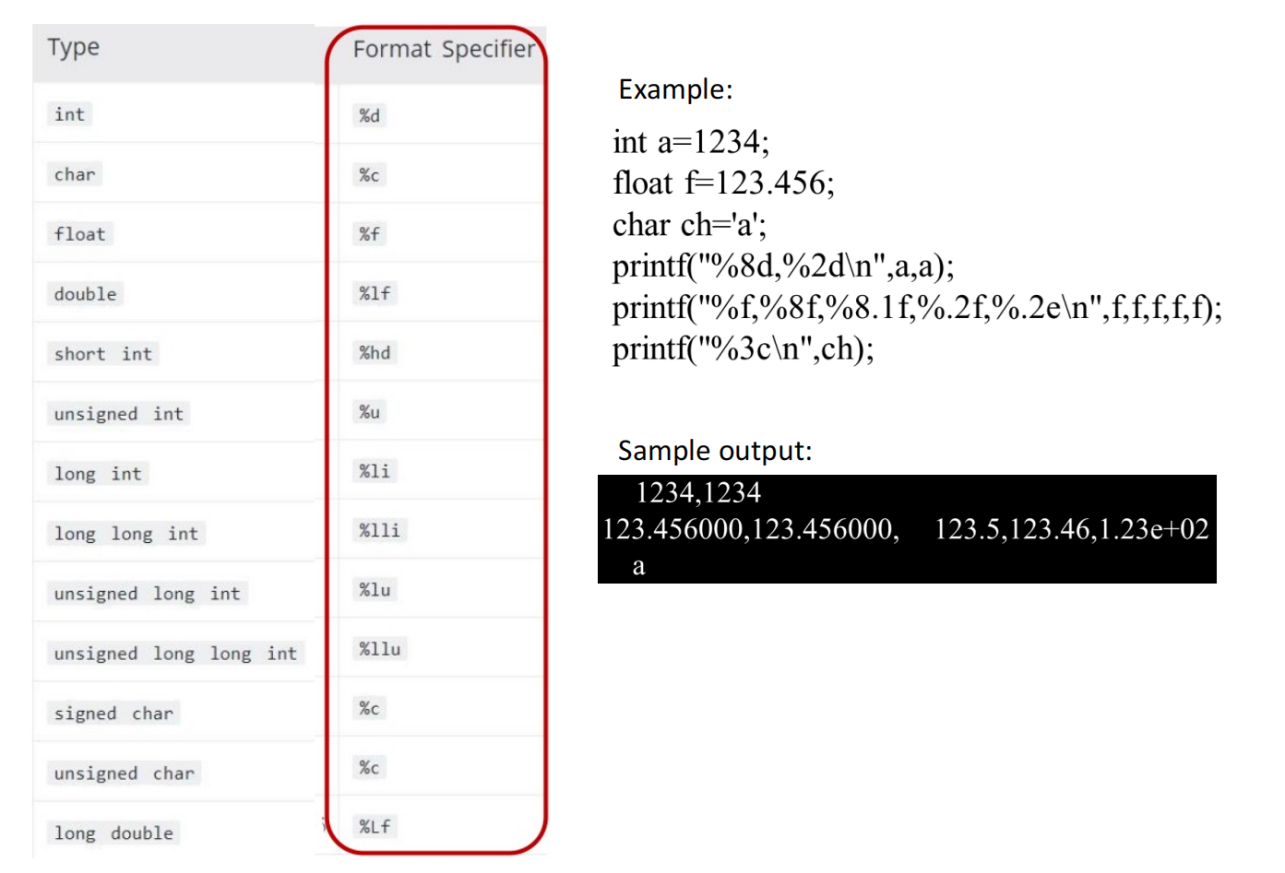
简单I/O
printf("Hello, value = %d\n", v);
int v;
int ret = scanf("%d", &v);

Slide 18
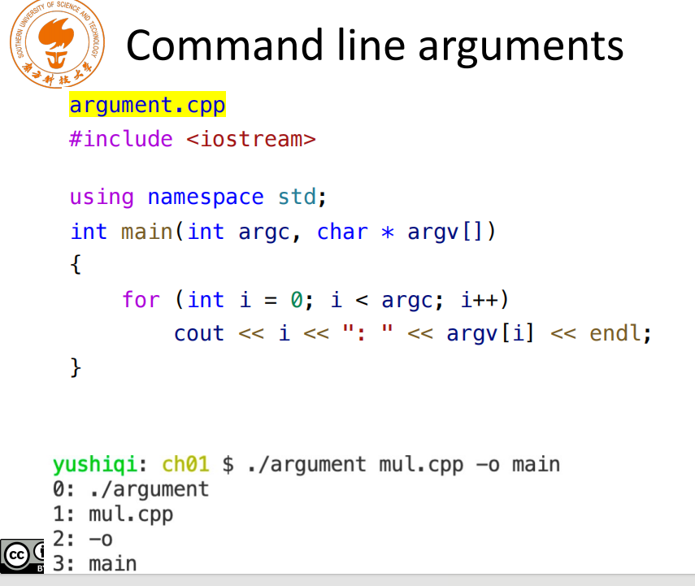
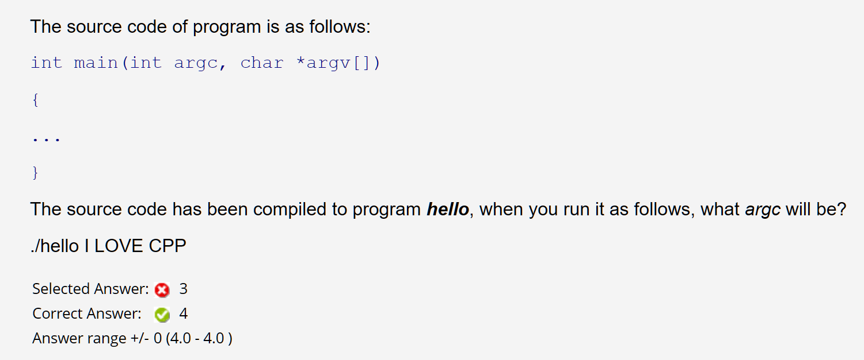
命令行输入

Slide 19
Week 02
数据类型

Slide 20
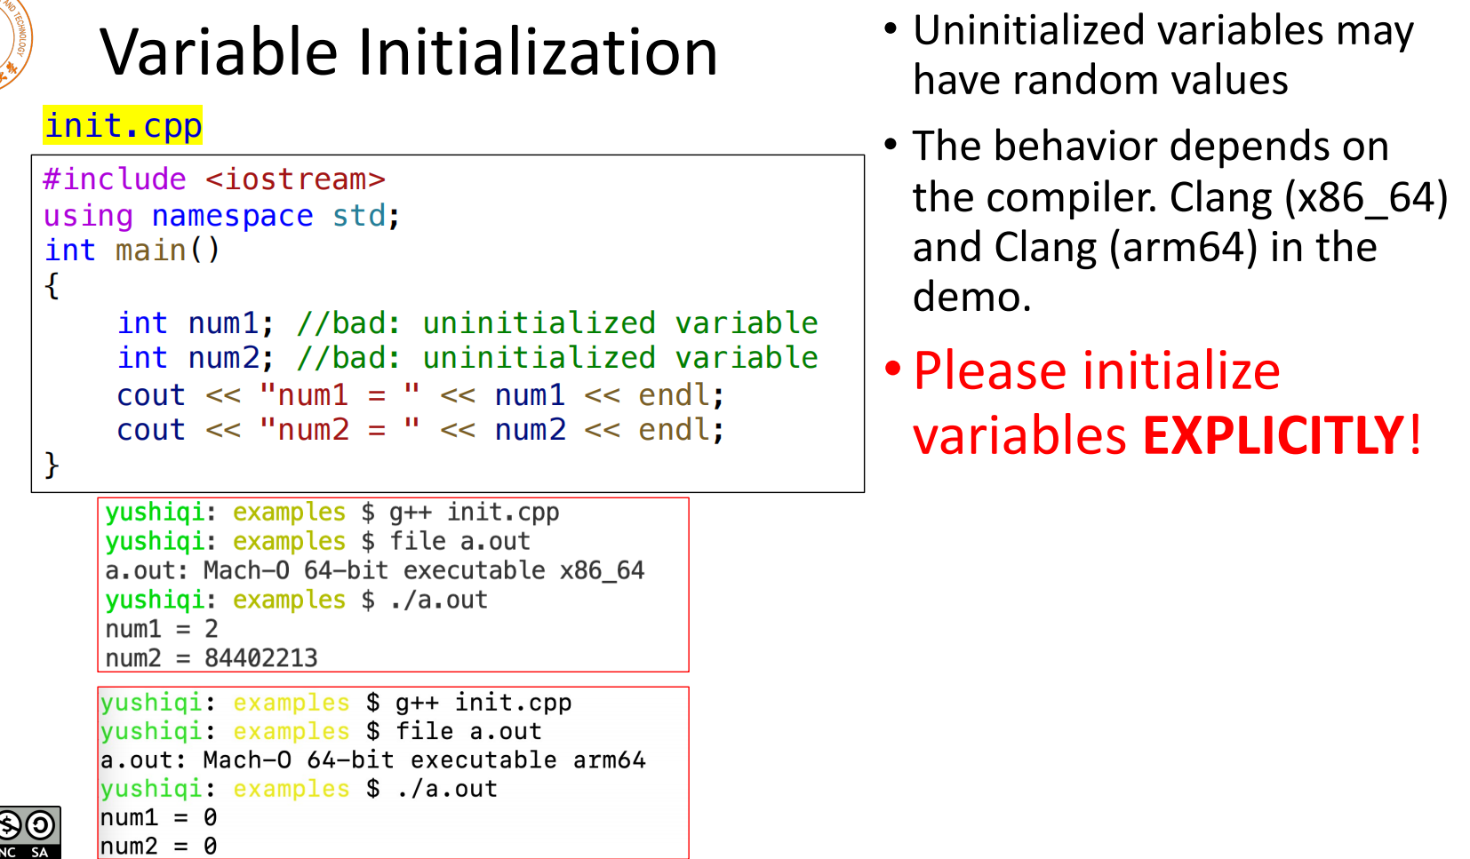
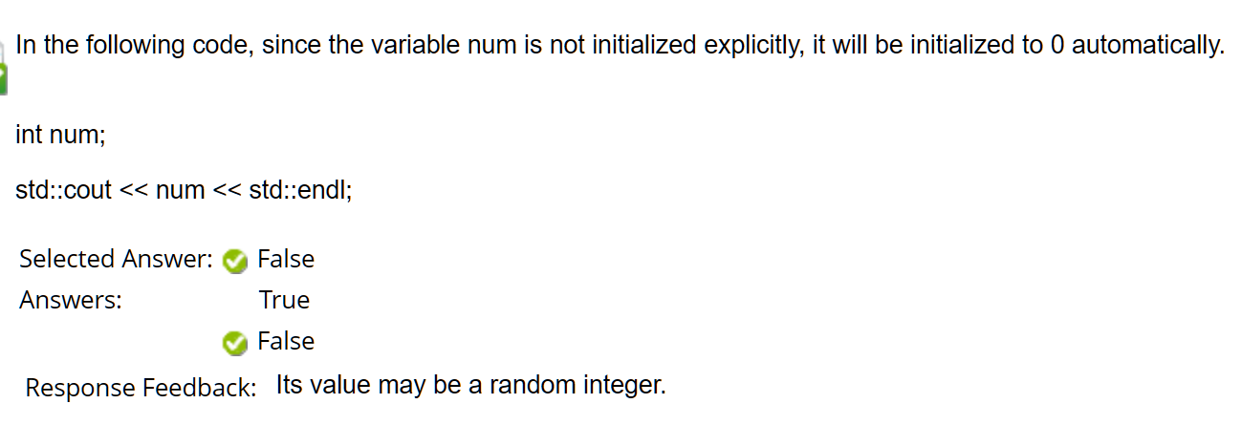
声明变量

Slide 21
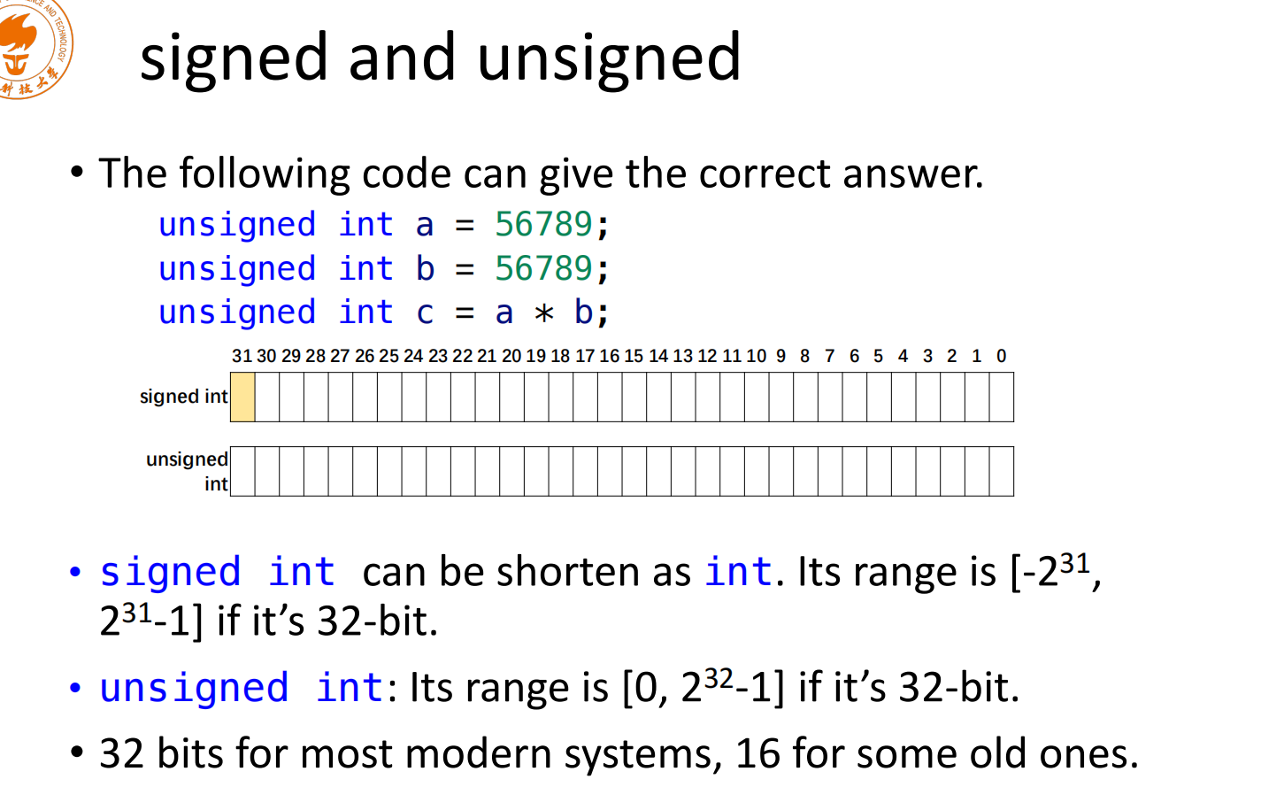
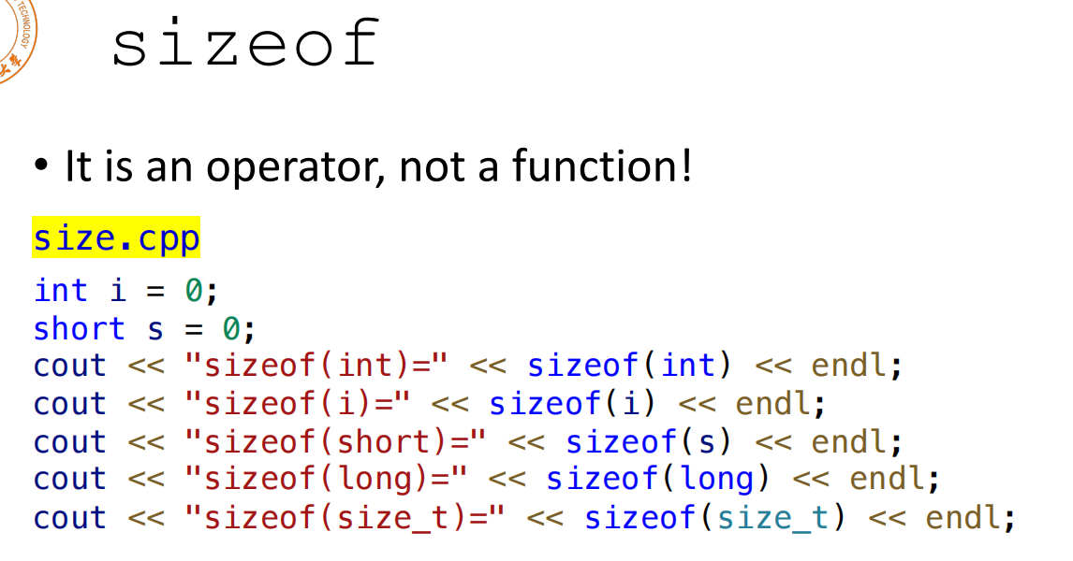
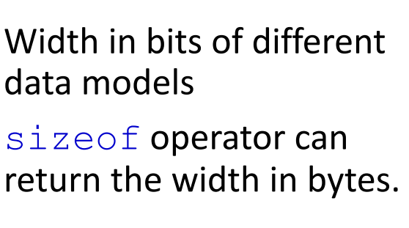
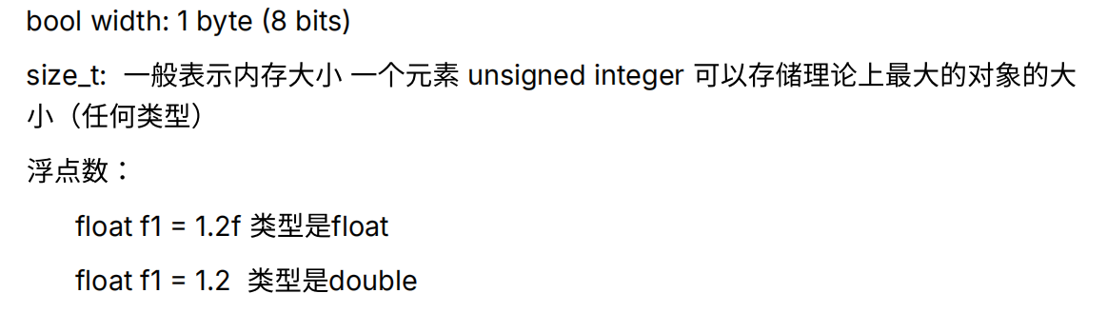
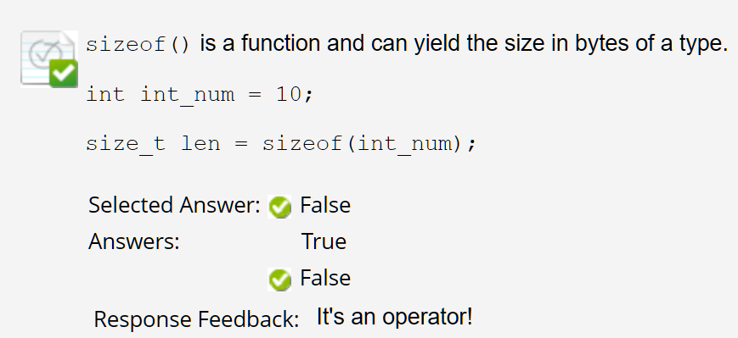
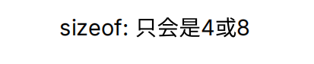

Slide 22
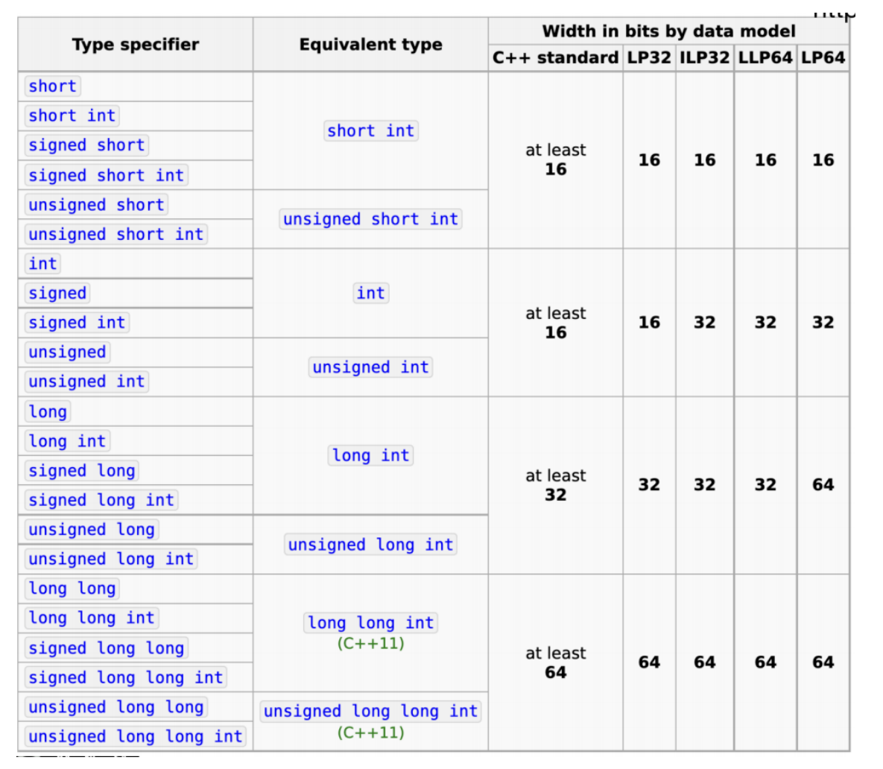
int

Slide 23
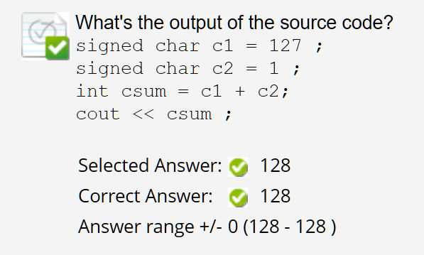
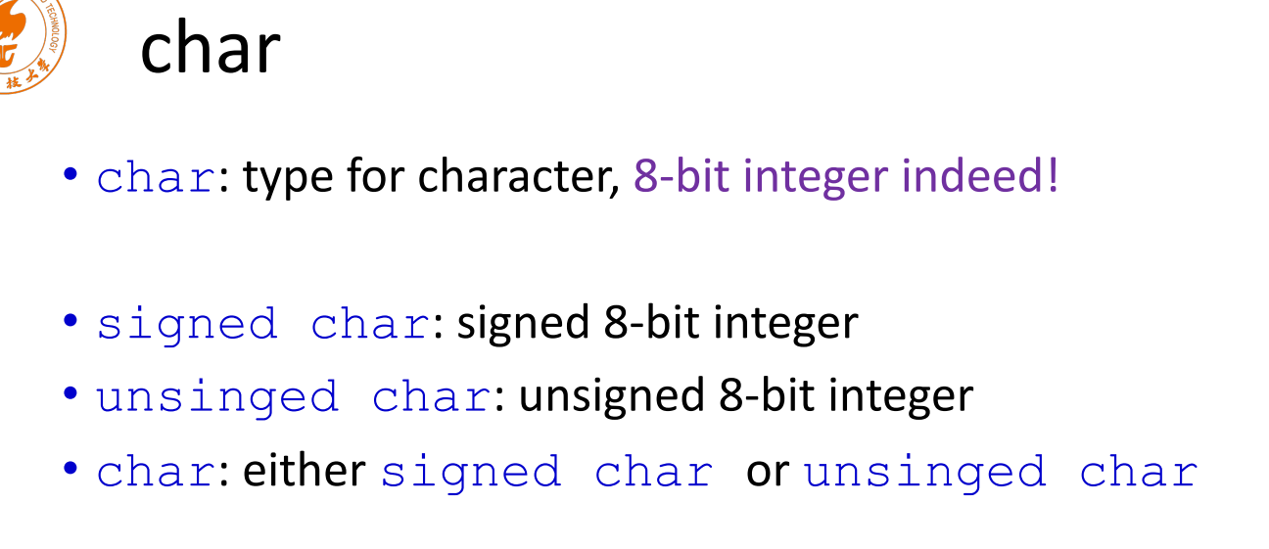
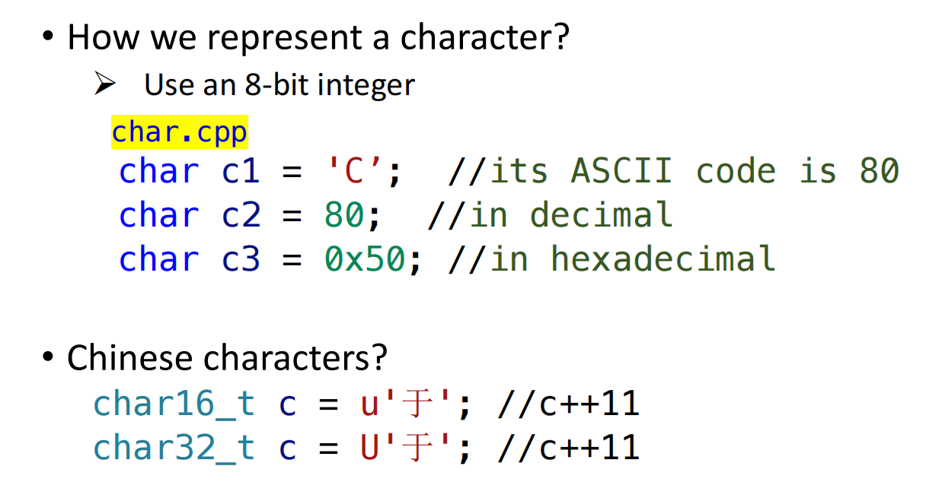
char
在进行加法运算时，c1 和 c2 都会被提升为 int 类型，这是因为在 C++ 中，小于 int 的整数类型（比如 char）在表达式中会自动被提升为 int。所以在表达式 c1 + c2 中，c1 和 c2 分别被提升为 int，然后进行加法运算。
在进行加法运算时，c1 和 c2 的值被当作有符号整数处理，因此 -128 加上 127 等于 127 - (-128) = 127 + 128 = 255。然而，由于 sum 的类型是 int，所以 sum 的值被截断为 255。这是因为 int 类型的范围是从 -2147483648 到 2147483647（在典型的32位系统中），所以 255 是在 int 范围内的有效值。

Slide 24
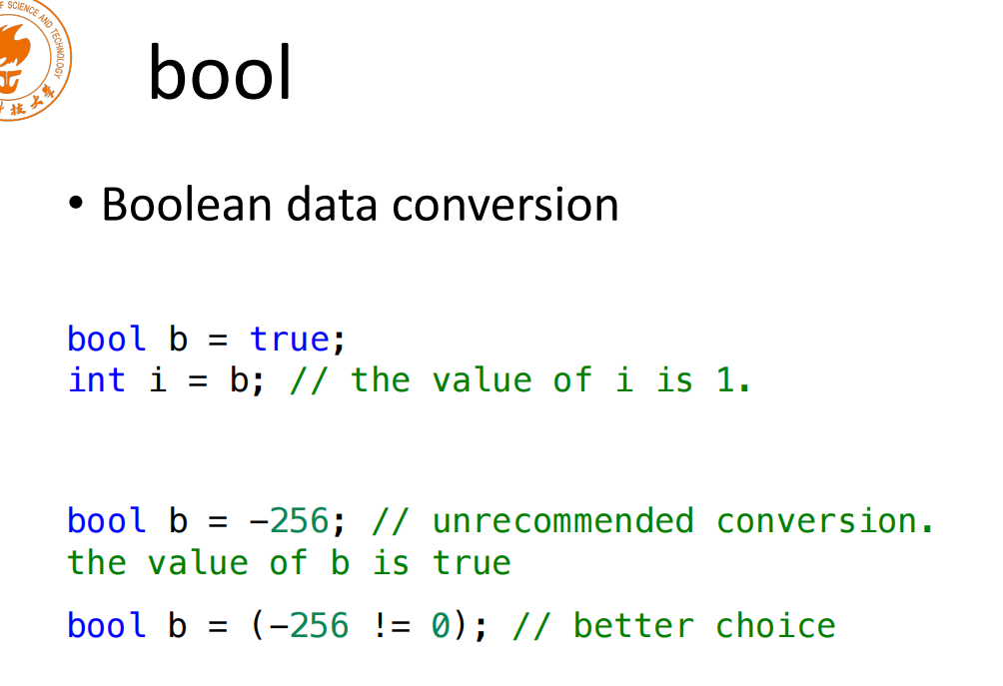


bool

Slide 25


size_t

Slide 26



float

Slide 27



太多了，怎么表示数字

Slide 28




Slide 29






Slide 30





用栈思考
1 1
微信公众平台 (qq.com)

Slide 31


Slide 32


我懒，怎么管理类：auto

Slide 33

lab

Slide 34

Week03
分支、循环

Slide 35


quiz

Slide 36


Slide 37


化简

Slide 38


Slide 39





非零数 true

Slide 40





Slide 41






Slide 42



Slide 43



Slide 44

Week04
数组、矩阵

Slide 45




Slide 46





Slide 47

虚拟内存

Slide 48




String

Slide 49





Slide 50



Struct & 对齐
C
C++

Slide 51


每个变量
The memory alignment rules of C++ require that data types be aligned to their natural boundaries. For example, integers (int) are generally aligned on 4-byte boundaries. This alignment optimizes the CPU's memory access.

Slide 52


对齐
struct 字节对齐详解_struct字节对齐-CSDN博客

Slide 53



对齐

Slide 54




Slide 55




Union

Slide 56

Enum

Slide 57




工程代码

Slide 58


Lab:makefile

Slide 59


Slide 60


Slide 61

Week05
指针

Slide 62



Announce a pointer
现代c++

Slide 63


What is a pointer

Slide 64






const

Slide 65





Slide 66



Slide 67

free
二次释放

Slide 68


C++

Slide 69

cmake

Slide 70

Week06
函数

Slide 71



检查函数输入
Project1

Slide 72

Func call

Slide 73





Slide 74






Slide 75





指针

Slide 76

summary
传int：copy
传int[]:pointer
传Matrix: 传递对象副本
传Matrix* / &Matrix：pointer

Slide 77


Pass structure

Slide 78





Slide 79


Reference as func para

Slide 80


return

Slide 81


inline

Slide 82

Week07
Default Arguments

Slide 83



Default argument
Only in C++!

Slide 84



Slide 85

Function Overloading
早期C是没有这个的

Slide 86




Function Templates

Slide 87


模版特化

Slide 88






Function Pointers and References

Slide 89




C/C++ feature

Slide 90


Recursive Functions

Slide 91



Slide 92

g++ -shared –fPIC –o libmath.so mymath.cpp

Slide 93

g++ -o main main.cpp –L. lmath

Slide 94


Slide 95

Week08
ARM、SIMD、OpenMP、OpenCV、CUDA

Slide 96







Slide 97





Slide 98


Slide 99




Slide 100


Project5
#include <stdio.h>
__global__ void mykernel() {
printf("Thread (%d, %d, %d) in Block (%d, %d, %d) of Grid (%d, %d, %d)\n",
threadIdx.x, threadIdx.y, threadIdx.z,
blockIdx.x, blockIdx.y, blockIdx.z,
gridDim.x, gridDim.y, gridDim.z);
}
int main() {
// 启动一个二维网格，每个网格包含两个线程块
dim3 gridDim(2, 1);
dim3 blockDim(1, 1);
mykernel<<<gridDim, blockDim>>>();
cudaDeviceSynchronize(); // 等待核函数执行完成
return 0;
}

Slide 101

Week09
Classes and Objects

Slide 102

Member Function

Slide 103





Constructors

Slide 104






Destructors

Slide 105



This pointer

Slide 106




Const variable & functions

Slide 107


const

Slide 108

Week10
cv::Mat、Operator overloading、friend Functions、Conversion

Slide 109





Operator overloading

Slide 110



Friend function

Slide 111




User-defined Type Conversion

Slide 112





Increment and decrement operators

Slide 113





Test!

Slide 114



Slide 115



Slide 116



Slide 117

Week11
Four important member functions，smart pointer

Slide 118



Slide 119



Notice on Default

Slide 120




Slide 121



浅拷贝

Slide 122



Slide 123


深拷贝

Slide 124



Slide 125


Soft Copy
Project4

Slide 126




Smart Pointers

Slide 127


Slide 128


Slide 129


Slide 130


Slide 131


Slide 132

Week12
Derived Classes

Slide 133

Derived Classes派生类：继承

Slide 134



Slide 135


Access Control

Slide 136


Slide 137



Virtual Functions

Slide 138


如果不用虚拟类：

Slide 139




Slide 140


Slide 141



Slide 142


Inheritance and Dynamic Memory Allocation
重新定义copy Con和动态内存

Slide 143







Slide 144


重写

Slide 145

Week13
Class Templates

Slide 146



Class Templates

Slide 147


Template Non-Type Parameters

Slide 148



Slide 149




Slide 150

部分专门化

Slide 151

std
string
array
allocator

Slide 152


Slide 153


Slide 154

Week14
stdio assert try catch throw

Slide 155

Standard Output Stream and Standard Error Stream

Slide 156


Slide 157


assert

Slide 158


Exceptions(only in C++)

Slide 159




A try block can be followed by multiple catch blocks

Slide 160


在哪里处理异常？

Slide 161



Slide 162


Slide 163



Slide 164


Slide 165



Slide 166



Slide 167


Slide 168


Slide 169

Week15
Friend Function

Slide 170




Slide 171




Slide 172



Slide 173


Nested Types嵌套类型

Slide 174


Slide 175

RTTI

